Slide 1


Intro to University Learning and teaching

Slide 2


Good Morning, How are you today?
ⓘ Start presenting to display the poll results on this slide.

Slide 3
Session outline
Experiential learning theory
Learning style
Learning pyramid

Slide 4
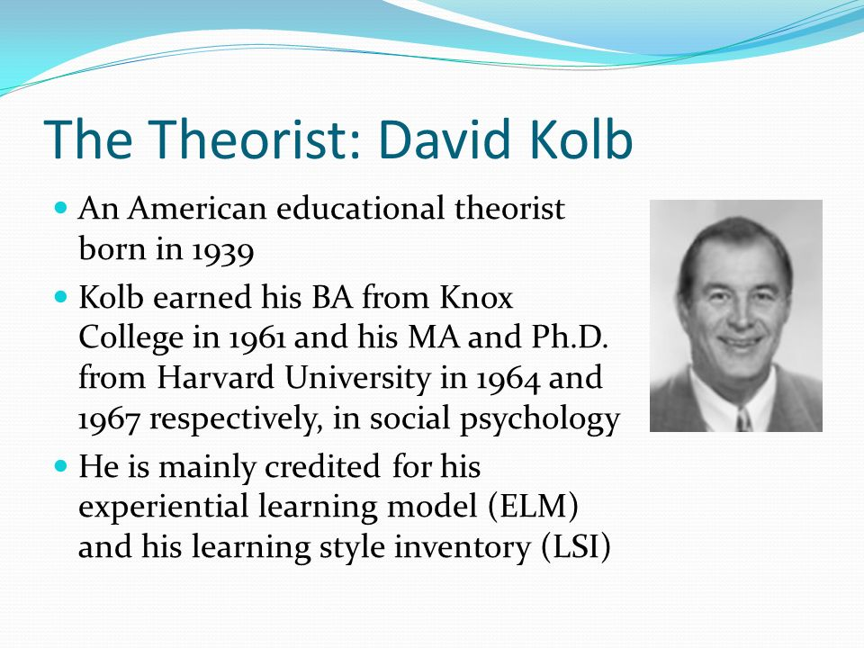

Slide 5
Experiential learning theory
As the name suggests, experiential learning involves learning from experience. The theory was proposed by psychologist David Kolb who was influenced by the work of other theorists including John Dewey, Kurt Lewin, and Jean Piaget.
"I believe that education, therefore, is a process of living and not a preparation for future living." - John Dewey, My Pedagogic Creed (1897)
“"The principle goal of education in the schools should be creating men and women who are capable of doing new things, not simply repeating what other generations have done.“ – Jean Piaget
There is nothing so practical as a good theory." —Kurt Lewin

Slide 6
Discuss what could be the features of experiential learning theory.

Slide 7
According to Kolb, this type of learning can be defined as "the process whereby knowledge is created through the transformation of experience. Knowledge results from the combinations of grasping and transforming the experience.“
Experiential learning theory differs from cognitive and behavioral theories in that cognitive theories emphasize the role of mental processes while behavioral theories ignore the possible role of subjective experience in the learning process.
The experiential theory proposed by Kolb takes a more holistic approach and emphasizes how experiences, including cognition, environmental factors, and emotions, influence the learning process.

Slide 8
Experiential Model Theory
In the experiential model, Kolb described two different ways of grasping experience:
Concrete Experience
Abstract Conceptualization
He also identified two ways of transforming experience:
Reflective Observation
Active Experimentation

Slide 9
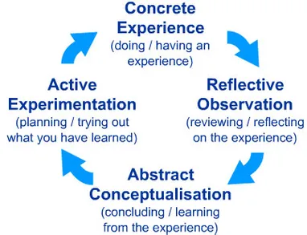

Slide 10
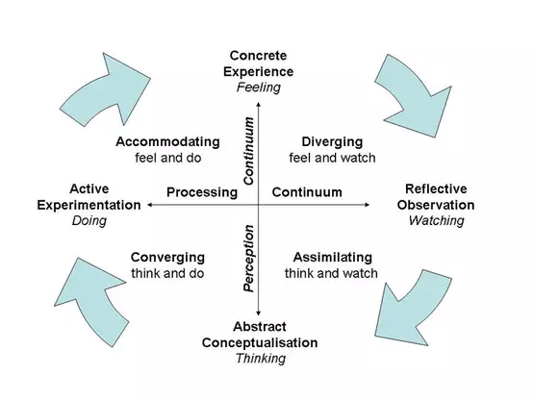
Kolb’s learning styles

Slide 11
What are the implications in the learning and teaching processes?

Slide 12
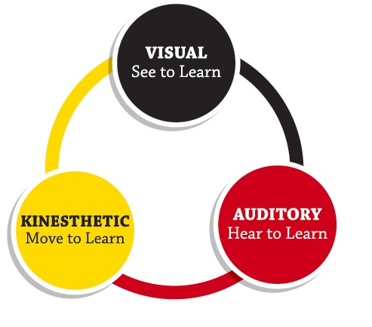
Learning styles

Slide 13
VAK
The VAK learning style uses the three main sensory receivers: Visual, Auditory, and Kinesthetic (movement) to determine the dominant learning style. It is sometimes known as VAKT (Visual, Auditory, Kinesthetic, & Tactile). It is based on modalities—channels by which human expression can take place and is composed of a combination of perception and memory.

Slide 14
VAK is derived from the accelerated learning world and seems to be about the most popular model nowadays due to its simplicity. While the research has shown a connection with modalities and learning styles (University of Pennsylvania, 2009), the research has so far been unable to prove the using one's learning style provides the best means for learning a task or subject. This is probably because it is more of a preference, rather than a style.

Slide 15
Learners use all three modalities to receive and learn new information and experiences. However, according to the VAK or modality theory, one or two of these receiving styles is normally dominant. This dominant style defines the best way for a person to learn new information by filtering what is to be learned. This style may not always to be the same for some tasks. The learner may prefer one style of learning for one task, and a combination of others for a different task.

Slide 16
Hints for Recognizing and Implementing the Three VAK Styles
Auditory learners often talk to themselves. They also may move their lips and read out loud. They may have difficulty with reading and writing tasks. They often do better talking to a colleague or a tape recorder and hearing what was said. To integrate this style into the learning environment:

Slide 17
Begin new material with a brief explanation of what is coming. Conclude with a summary of what has been covered. This is the old adage of “tell them what they are going to lean, teach them, and tell them what they have learned.”
Use the Socratic method of lecturing by questioning learners to draw as much information from them as possible and then fill in the gaps with you own expertise.
Include auditory activities, such as brainstorming, buzz groups, or Jeopardy. Leave plenty of time to debrief activities. This allows them to make connections of what they leaned and how it applies to their situation.
Have the learners verbalize the questions.
Develop an internal dialogue between yourself and the learners.

Slide 18
Visual learners have two sub-channels—linguistic and spatial. Learners who are visual-linguistic like to learn through written language, such as reading and writing tasks. They remember what has been written down, even if they do not read it more than once. They like to write down directions and pay better attention to lectures if they watch them. Learners who are visual-spatial usually have difficulty with the written language and do better with charts, demonstrations, videos, and other visual materials. They easily visualize faces and places by using their imagination and seldom get lost in new surroundings. To integrate this style into the learning environment:

Slide 19
Use graphs, charts, illustrations, or other visual aids.
Include outlines, concept maps, agendas, handouts, etc. for reading and taking notes.
Include plenty of content in handouts to reread after the learning session.
Leave white space in handouts for note-taking.
Invite questions to help them stay alert in auditory environments.
Post flip charts to show what will come and what has been presented.
Emphasize key points to cue when to takes notes.
Eliminate potential distractions.
Supplement textual information with illustrations whenever possible.
Have them draw pictures in the margins.
Have the learners envision the topic or have them act out the subject matter.

Slide 20
Kinesthetic learners do best while touching and moving. It also has two sub-channels: kinesthetic (movement) and tactile (touch). They tend to lose concentration if there is little or no external stimulation or movement. When listening to lectures they may want to take notes for the sake of moving their hands. When reading, they like to scan the material first, and then focus in on the details (get the big picture first). They typically use color high lighters and take notes by drawing pictures, diagrams, or doodling. To integrate this style into the learning environment:

Slide 21
Use activities that get the learners up and moving.
Play music, when appropriate, during activities.
Use colored markers to emphasize key points on flip charts or white boards.
Give frequent stretch breaks (brain breaks).
Provide toys such as Koosh balls and Play-Dough to give them something to do with their hands.
To highlight a point, provide gum, candy, scents, etc. which provides a cross link of scent (aroma) to the topic at hand (scent can be a powerful cue).
Provide high lighters, colored pens and/or pencils.
Guide learners through a visualization of complex tasks.
Have them transfer information from the text to another medium such as a keyboard or a tablet.

Slide 22
